Slide 1

AI in business
Max Darby
DARBYM1@TCD.ie

Slide 2
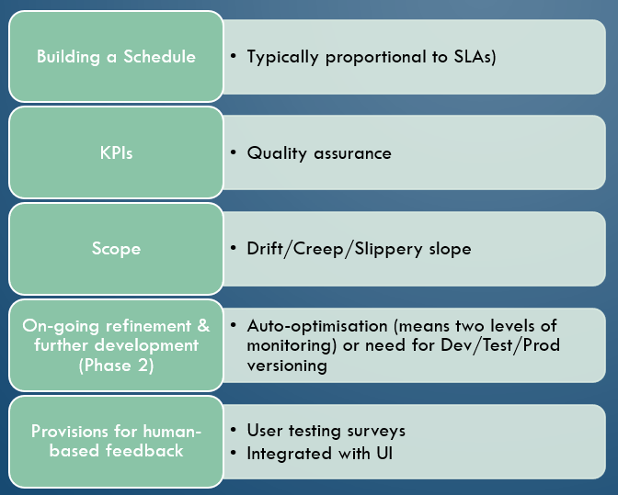
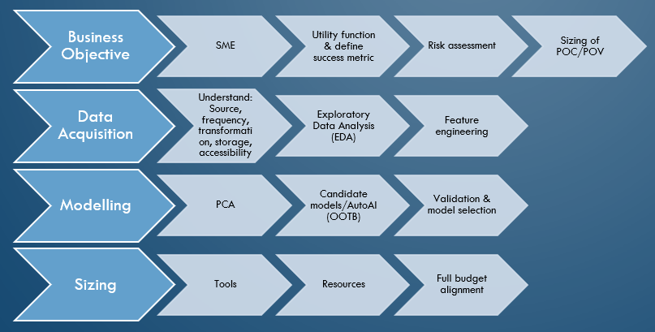
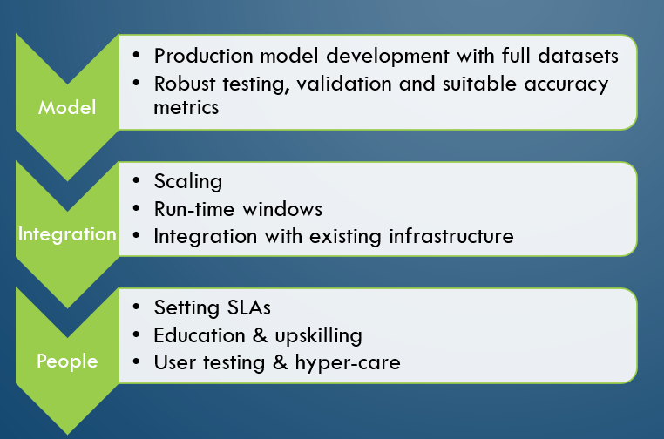
This week: AI Development/Strategy
STAGE 1: DEVELOPMENT
STAGE 2: DEPLOYMENT
STAGE 3: MAINTENANCE

Slide 3
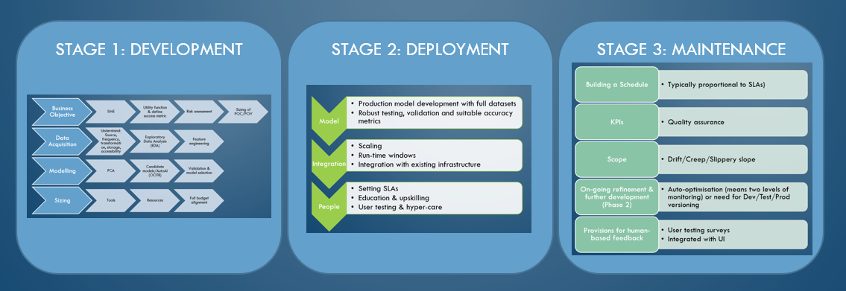
Stage 1: Development
Business Objective
Subject Matter Expert
Utility function & define success metric
Risk assessment
Sizing of POC/POV
Data Acquisition
Understand: Source, frequency, transformation, storage, accessibility
Exploratory Data Analysis (EDA)
Feature engineering
Modelling
Principle Component Analysis
Candidate models/AutoAI out-of-the-box (OOTB)
Validation & model selection
Sizing
Resources
Full budget alignment
Tools
Worth thinking about at this stage:
Proof Of Concept vs. Proof Of Value
Documentation
Auditing
Reproduction
Maintenance
Winning hearts & minds
Communicate stages in clear language & manage expectations
Potential for discovering nested projects

Slide 4
Stage 2: Deployment
Model
Robust testing, validation and suitable accuracy metrics
Integration
Integration with existing infrastructure
People
Education & upskilling
User testing & hyper-care
Production model development with full datasets
Scaling
Run-time windows
Setting Service Level Agreements (SLA)
Batch vs Model Serving (API)
Worth thinking about at this stage:
Overall Governance:
Ownership
Scope & definitions
Intellectual Property
Tools
Usually dictated by IT/company existing infrastructure.

Slide 5
Stage 3: Maintenance
Building a Schedule
KPIs
Scope
On-going refinement & further development (Phase 2)
Auto-optimisation (means two levels of monitoring) or need for Dev/Test/Prod versioning
Provisions for human-based feedback
Typically proportional to SLAs
Quality assurance
Drift/Creep/Slippery slope
User testing surveys
Integrated with User Interface
Output being used in another model
Algorithmic Governance
Transparency/XAI
Bias/Fairness
Responsibility and Liability
Lineage
Control
Privacy
Autonomy/’opt-out’-ability
Compliance
Notes:
‘A Citizen’s Guide to Artificial Intelligence’ John Zerilli

Slide 6


Sample: you are the head of analytics in Shell
New legislation dictates you must do everything in your power to ensure no wildlife is directly impacted in the case of an accident in your transport operations (i.e., an oil spill at sea). They demand to see evidence of a data-driven approach to your transportation that factors in significant ecological priorities (e.g., endangered species).

Slide 7
Stage 1: Development
Business Objective: risk score for entering an area where an endangered species will be.
Subject Matter Expert: ecological experts, data scientist (with ecological experience), system safety and environmental safety engineers, internal routing experts.
Utility function & define success metric: Risk score
Risk assessment: fatality of endangered species (if we get it wrong) & associated fines, reputational assets/PR.
Sizing of POC/POV: 2 data scientists, ecological expert (1 month), SSESE (project leads), €50k compute/consultancy/coffee.
Data Acquisition
Understand: Source, frequency, transformation, storage, accessibility
Create our maps of ‘high risk’ areas (from puffin data acquired from university).
Detect potential crossover: using EU risk maps (detect potential crossover), Transportations routes, Seabird migration maps (puffin migration data).
Evaluate risk: Environmental hazard assessment > Risk Matrix
Room for further quantification: ICAF (existing models) (quantify crossover).
Exploratory Data Analysis (EDA)
Feature engineering

Slide 8
Sub-project 1: Stage 1: Development
Business Objective: Create our maps of ‘high risk’ areas (from puffin data acquired from university).
Subject Matter Expert: ecological experts, data scientist,
Utility function & define success metric: We can accurate predict where puffins will be when they are flightless.
Risk assessment: fatality of endangered species (if we get it wrong) & associated fines, reputational assets/PR.
Sizing of POC: 2 data scientists, ecological expert (1 month), SSESE (project leads).
Data Acquisition
Understand: Source, frequency, transformation, storage, accessibility
Puffin data: batched file of leg data (dry/wet, light/dark) last 5 years
Exploratory Data Analysis (EDA)
We discover that the data is extremely noisy as a result of puffin ‘leg-tucking’ which creates false ‘dry’ readings when the puffin is actually at sea.
Feature engineering
We take the raw inputs of 0/1, pass them through a pre-trained model and categorise them as ‘in flight’/’on sea’…
Convert light/dark to latitude/tongitude.

Slide 9
Stage 1: Development
Modelling
Principle Component Analysis
Candidate models/AutoAI out-of-the-box (OOTB)
Markov chain (BirdFlow API).
Validation & model selection
You consult your SME: they recommend BIRDFLOW API.
Is this company a viable option? What validation do they offer? Can you validate their outputs yourself or are you reliant?
Agree output:
Latitude/Longitude, Time/Day, Flag for ‘Flightless’ (i.e., high-risk).
Sizing
Tools – Azure Cloud storage, Databricks, Birdflow API, Tableau
Resources – integration specialists, Data scientists, dashboard designers
Full budget alignment

Slide 10
Stage 2: Deployment

Slide 11
Stage 3: Maintenance

Slide 12
Full AI Disruption
‘AI factory’ (decision-factory): ‘Analytics systematically convert internal and external data into predictions, insights, and choices, which in turn guide and automate operational workflows’.
Third parties providing this AI as a service – ‘blurring the lines that used to separate industries and is upending the rules of business competition’
Doesn’t even need to be that sophisticated, but needs to be the centre of the business.
Ant Financial Services Group: ‘There are no workers in its “critical path” of operating activities’.
Notes:
‘Competing in the Age of AI: How machine intelligence changes the rules of business’ – Marco Iansiti and Karim R. Lakhani. HBR Jan 2020.

Slide 13
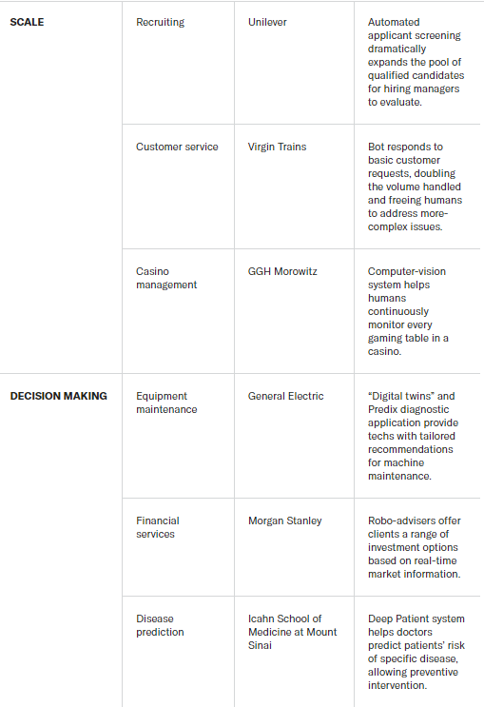
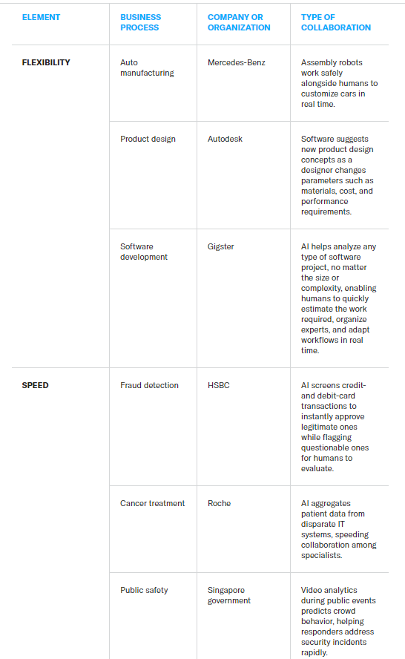
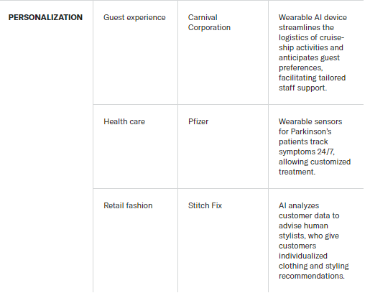
Needing machines
GNS Healthcare applies machine-learning software to find overlooked relationships among data in patients’ health records…This approach enabled GNS to uncover a new drug interaction hidden in unstructured patient notes… “Our machine-learning platform is not just about seeing patterns and correlations… it’s about actually discovering causal links”
Notes:
Collaborative Intelligence: Humans and AI Are Joining Forces – H. James Wilson and Paul R. Daugherty, 2018 HBR
Amazon warehouse structure (chaos) for decision making

Slide 14
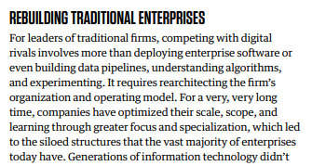
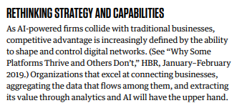
Using AI in an existing business
Greatest gains come from collaboration – empowering humans with AI.
Companies that use AI to automate/replace typically only see short term gains
Unfortunately, the latter is easier to conceptualise – take an existing process and replace it, rinse and repeat.
Much harder to bring around deeper change to engrained silos and business processes – but it is possible!
E.g., Microsoft becoming an AI-driven firm – process-first, thinking of each process as a ‘product’ with humans using AI to implement it, additionally centralising their internal data resources to better support their employees in using AI in their role (e.g., shared software library, algorithms repository and data catalog).

Slide 15
Needing Humans: Training/Explaining/Sustaining
The people involved in these stages aren’t (and shouldn’t be) purely data scientists.
Train
Subject matter experts
E.g., Cortana’s trainers included a poet, a novelist, and a playwright or Siri being intentionally trained to be slightly ‘sassy’.
Explain
Visualisation/interpretation, social scientists
E.g. GDPR requirement for explanation for any algorithmic decision
Sustain
Philosophers (ethicists), SMEs
‘employees who continually work to ensure that AI systems are functioning properly, safely and responsibly’
And handling uncertainty and equivocality..
Notes:
‘Collaborative Intelligence: Humans and AI Are Joining Forces’ – H. James Wilson & Paul R. Daugherty – HBR 2018

Slide 16
However..
“humans retain the comparative advantage when addressing uncertainty and equivocality in decision making as they can leverage their superior intuition, imagination, and creativity”.
The skill here is identifying areas where a human is better suited than AI. Which is difficult, especially considering how business processes are becoming increasingly robotic.
‘Understanding purpose’ coupled with AI/human collaboration is a useful tool for avoiding overly robotic processes, which also factors in an allowance for creativity/intuition.
Ends > Means
Notes:
Artificial Intelligence and the future of work: Human-AI symbiosis in organisational decision making’ – Mohammad Hossein Jarrahi, 2018
https://www.sciencedirect.com/science/article/abs/pii/S0007681318300387?via%3Dihub

